Slide 1
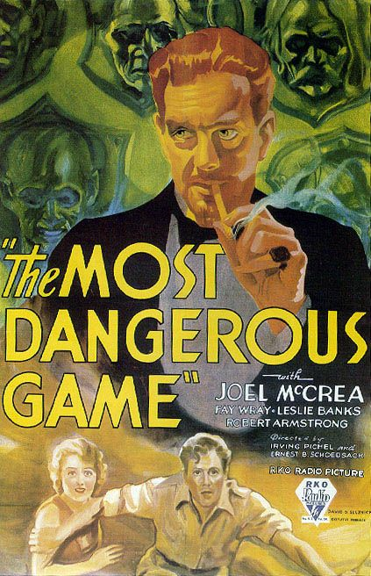
Vocabulary in “The Most Dangerous Game”
A vocabulary project-based learning activity

Slide 2
Why do we need to learn new vocabulary words?
ELA8R2 The student understands and acquires new vocabulary and uses it correctly in reading and writing.

Slide 3
Vocabulary from “The Most Dangerous Game”
Palpable
Taint
Tangible
Indolence
Bland
Lacerated
Opaqueness
Disarming
Amenities
Debacle
Affable
Droll
Opiate
Solicitous
Ennui
Quarry
Venerable
Agility
Leech
Placid

Slide 4
Vocabulary Comic Life
Everyone is assigned a word
For your word, you will create a comic life project with the following information
Word (with page # from the text)
Dictionary definition
Other forms of the word
Synonym
Antonym
Sentence from the text with the word
Your own sentence
Mnemonic device (to help us all remember the word)
Use your textbook, dictionary.com, and your brain!

Slide 5
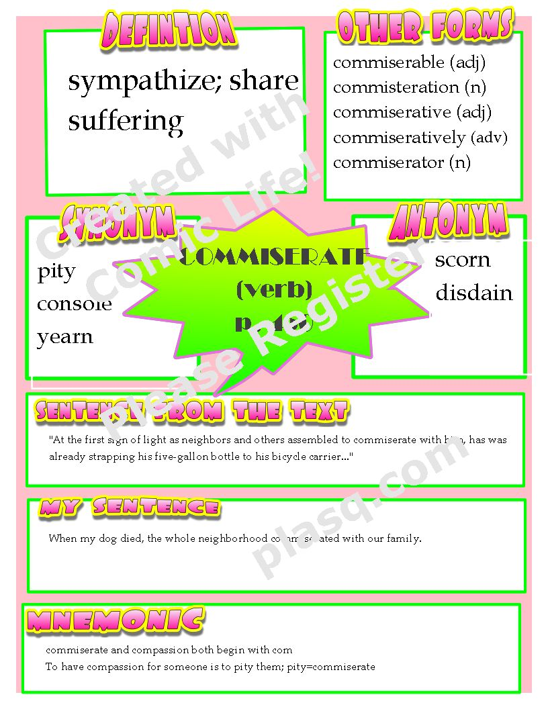
Click here to go to the actual document

Slide 6
Why do we present our information?
ELA8LSV2.a Gives oral presentations or dramatic interpretations for various purposes.
ELA8LSV2.g Uses multimedia for presentations.

Slide 7
Oral Presentation
Your comic life project will be on the Smart Board
You will present your project to the class
You will be graded by your classmates, and by Mrs. Lowery using the oral presentation rubric we created at the beginning of the semester

Slide 8
 | 4 | 3 | 2 | 1
Preparedness | The student is completely prepared and has rehearsed. | The student seems pretty prepared but needed a couple more rehearsals. | The student is somewhat prepared, but it is clear rehearsal was lacking. | The student does not seem at all prepared to present.
Enthusiasm | Facial expressions and body language show strong interest and enthusiasm about the topic. | Facial expression and body language sometimes show strong interest and enthusiasm. | Facial expressions and body language rarely show strong interest and enthusiasm. | Very little use of facial expressions or body language. Does not seem interested in the topic.
Listens to Other Presentations | Listens intently. No distracting noises or movements. | Listens intently but has one distracting noise or movement | Sometimes does not appear to be listening but is not distracting. | Does not appear to be listening and/or makes distracting noises.
Speaks Clearly | Speaks clearly all of the time | Speaks clearly, but mispronounces a word or two | Speaks clearly most of the time. | Often mumbles or cannot be understood or mispronounces several words
Content (x2) | Shows a full understanding of the topic | Shows a good understanding of the topic. | Shows a good understanding of parts of the topic. | Does not seem to understand the topic very well.
Posture and Eye Contact | Stands up straight, looks relaxed and confident. Establishes eye contact with everyone in the room. | Stands up straight and establishes eye contact with everyone. | Sometimes stands up straight and establishes eye contact. | Slouches and/or does not look at people during the presentation.
RUBRIC

Slide 9
Need additional help?
Check out the following website for games using these vocabulary words
http://quizlet.com/401377/the-most-dangerous-game-vocabulary-flash-cards/

Slide 10
Credits
http://www.impawards.com/1932/most_dangerous_game.html
http://comiclife.com/
http://www.dreamstime.com/royalty-free-stock-photo-podium-speech-image10888665
http://www.istockphoto.com/file_closeup/arts-and-entertainment/writing/3876832-abc.php?id=3876832

