Slide 1
Technology Integration
Ron Hickey
8461 Diffusion of Innovations
Interview Project

Slide 2
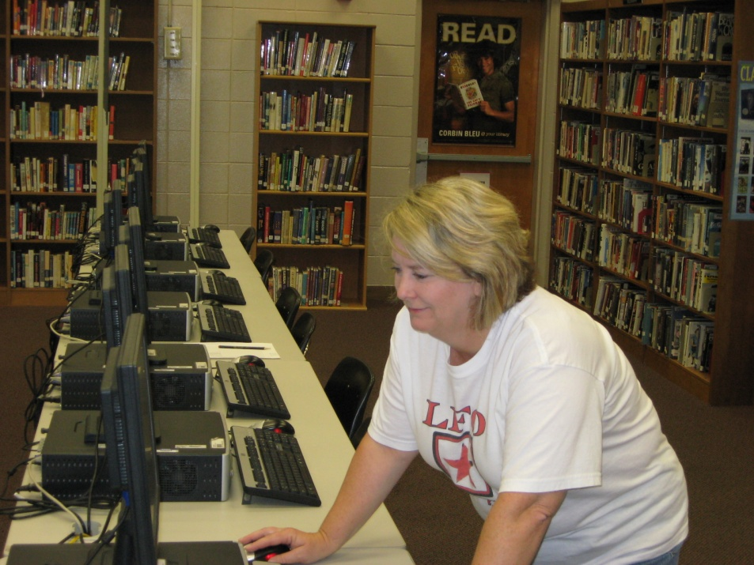
Media Specialist –Susan Mulkey Lakeview Fort Oglethorpe High School
B.S. – Elementary Education
M.Ed. – Media Education
Ed.S. – Instructional Leadership

Slide 3
What is your current job, and what does it entail?
I am the media specialist at LFO High School. I am responsible for everything that happens in the media center. I do not have a planning period, and I usually eat my lunch standing up while monitoring about 70 kids during our hour long lunch. I assist teachers in doing research and other projects where they need electronic and print resources or additional information. I sometimes teach skills such as web site evaluation. I am responsible for teaching teachers Internet skills. I oversee one paraprofessional. I have a budget which must be carefully spent on books, periodicals, networked software programs, equipment, supplies, etc. I take this responsibility seriously and read reviews for everything I purchase (from the 300 or more books to the DVD/VCR players…). I also oversee the morning announcements and place announcements on the digital signage which runs during lunch in the cafeteria and hallways. In addition I troubleshoot problems with computers and printers, TVs, DVD/VCR players, LCD and overhead projectors, etc. I run the backup tape every day. My para-pro and I enter all the 300 or so freshmen computer logins. I plan 2 or 3 big events for the media center each year including Teen Read Week activities, Teen Tech Week activities, and National Library Week activities. We run a week long book fair twice a year. I serve on the School Improvement Team, the Technology Committee, the Media Committee, and was on the Steering Committee for Senior Project as well as a member of the Freshmen Academy Team. This year I am sponsoring the Freshmen Class.
Click to advance through the rest of the presentation.

Slide 4
How is technology affecting the learning process?
I think the better question is how does technology NOT affect the learning process? The use of technology is so integral to the lives of our students that the regular classroom situation is quickly becoming obsolete. As I mentioned before, we have networked software programs for research, internet searching options, and a wide range of electronic resources at our disposal. In addition, teachers are begging for technology to use in their classrooms including smart boards, document cameras, LCD projectors, laptops, and more. In addition, teachers are requiring students to complete projects in creative and technology related ways, the least of which includes word processing and PowerPoint. The money, or lack of it, in education is putting our country further and further behind

Slide 5
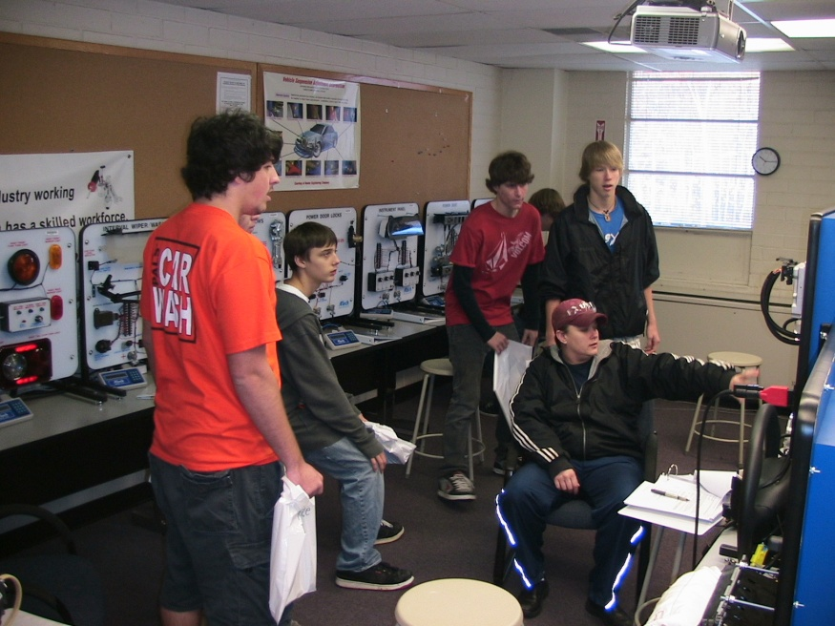
What is your definition of technological literacy?
Technological literacy is the ability to use a wide variety of electronic resources including computers, LCD projectors, document cameras, smart boards and others in a way in which it enriches one’s life while increasing his or her productivity. It means being comfortable with the applications and having the ability to troubleshoot problems when they occur.

Slide 6
What does “technology integration” mean to you?
Technology integration is what students are doing today. They are incorporating technology into every aspect of their lives from social to educational. It means that the use of technology is second nature. We don’t have to think about it or talk about it. It is a given in any lesson.
What role do you play in integrating technology, and how do you involve others?
Well, I see my role as a facilitator. I provide the technology. I can provide the training. I can encourage and recommend. I can even do it for them in a lesson or two.

Slide 7
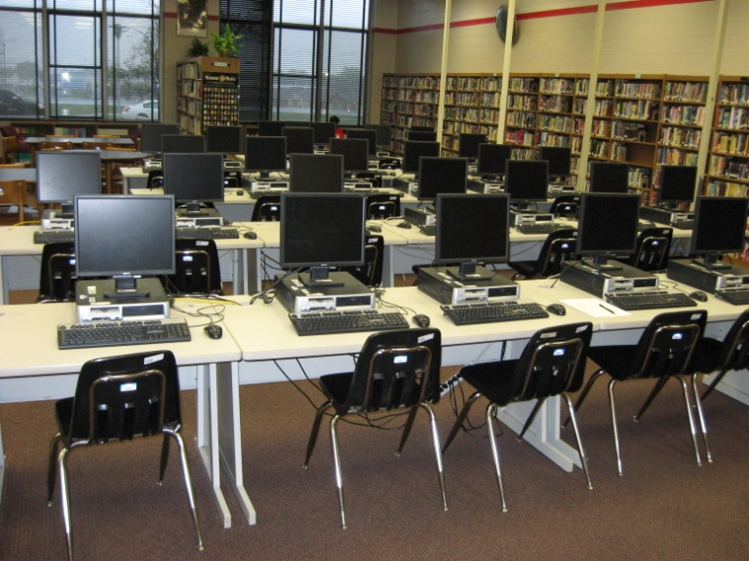
Do you have a technology integration success story?
I don’t know if this is a success story or not…But, I was helping a math teacher set up a laptop and projector to show a clip for her classroom, and I thought, hey, this is the first time this teacher has used this technology. I hope it is the first of many.

Slide 8
What are some obstacles you have encountered when trying to integrate technology into the school environment?
Outright opposition to any new technology is always an issue. In some cases it isn’t outright opposition, it is just indifference. The major issue right now is not getting teachers to want to use technology, the problem is getting the money to provide teachers with the technology.

Slide 9
Credits
Photos and video © Ron Hickey

