Slide 1
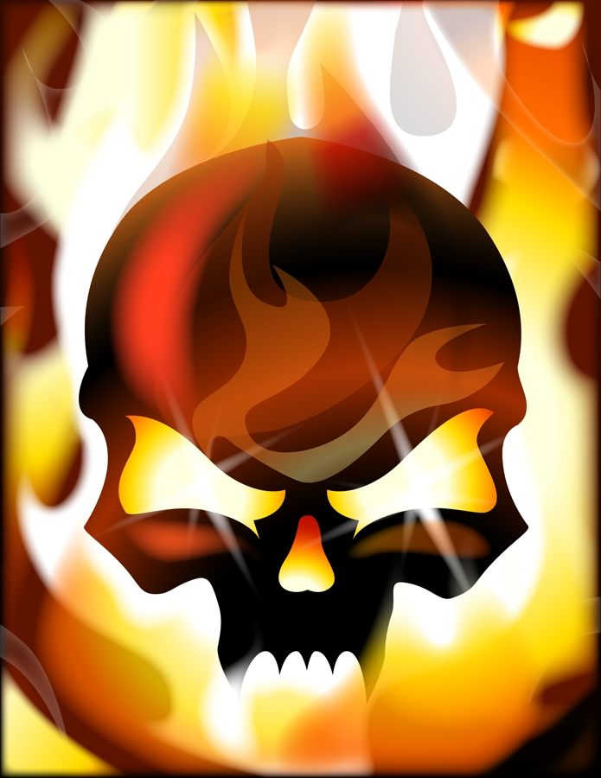

Jabberwocky
Ron Hickey
Media 7468
eBook Project

Slide 2
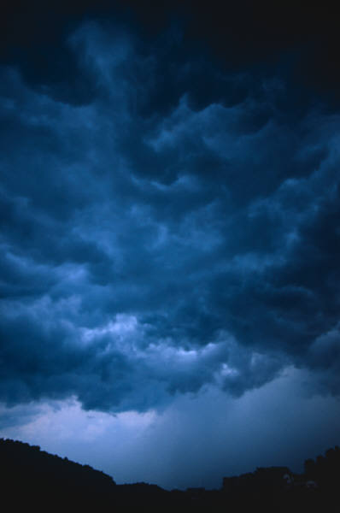

‘Twas brillig,

Slide 3
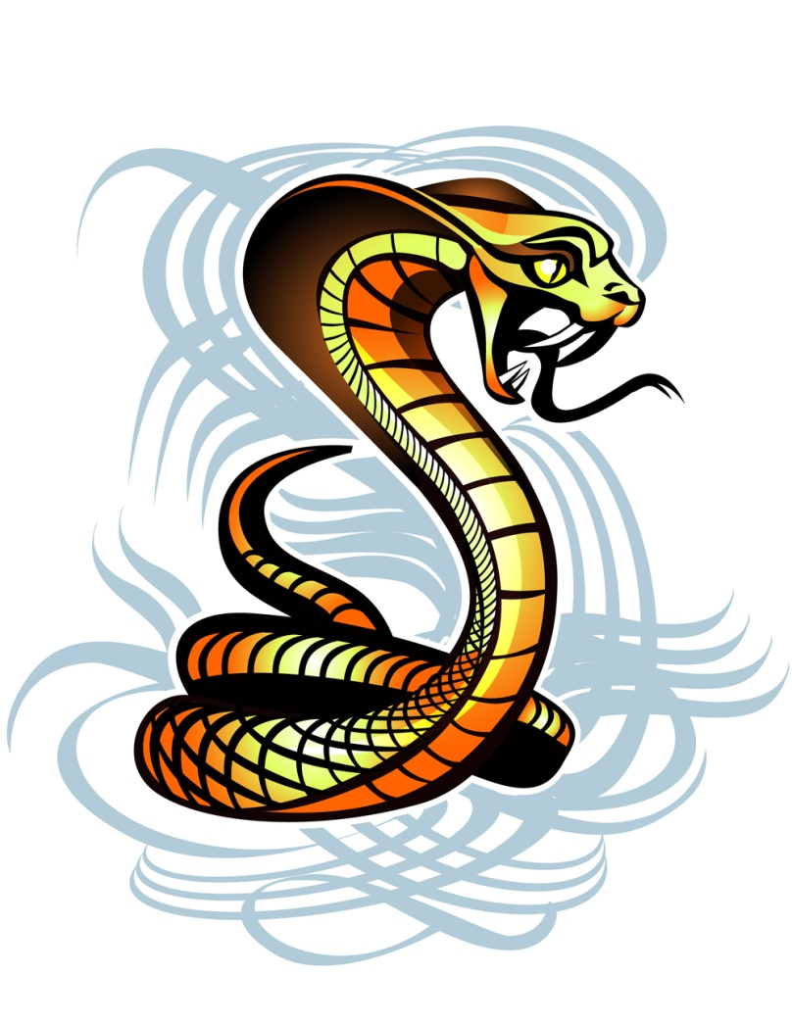
and the slithy toves
Did gyre and gimble in the wabe:

Slide 4
All mimsy were the borogroves.

Slide 5
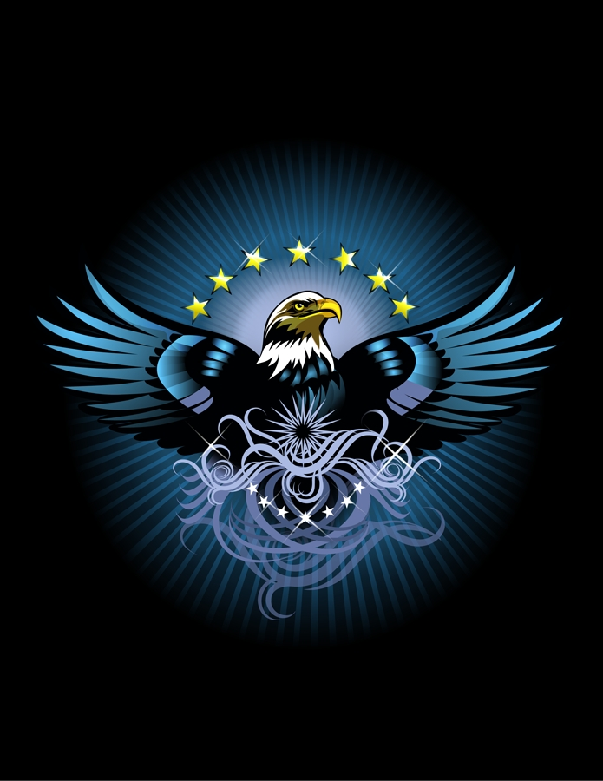
And the mome raths outgrabe.

Slide 6
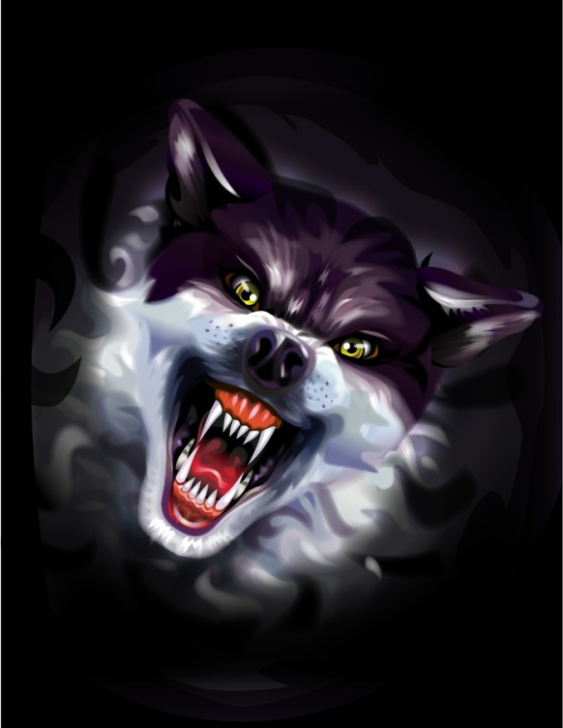
“Beware the Jabberwock, my son!
The Jaws that bite, the claws that catch!

Slide 7
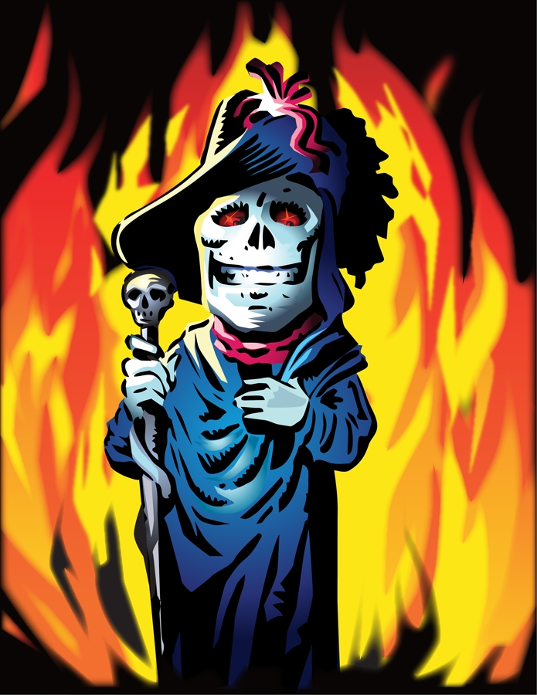
Beware the Jubjub Bird, and shun the frumious Bandersnatch!”

Slide 8
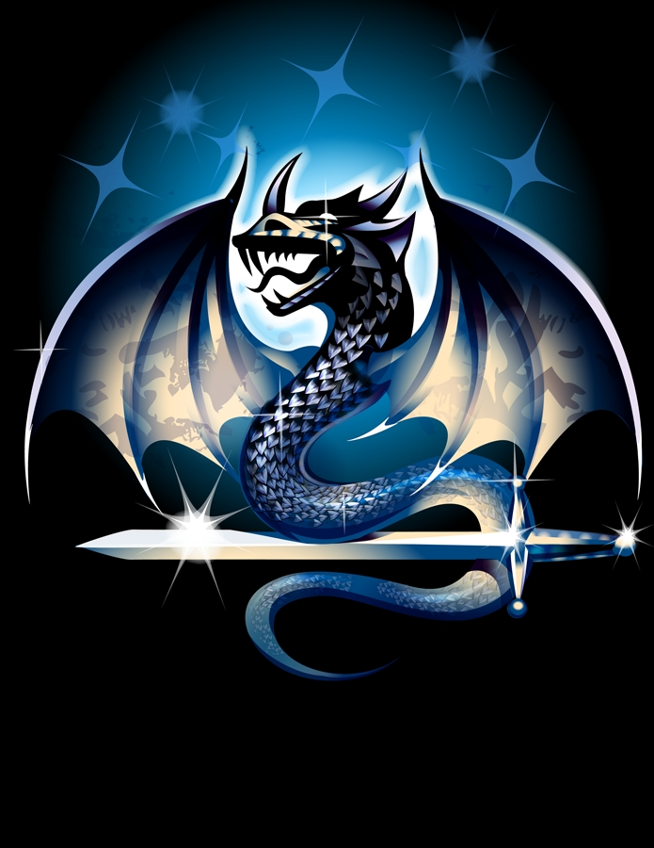
He took his vorpal sword in hand:
Long time the manxome foe he sought--

Slide 9
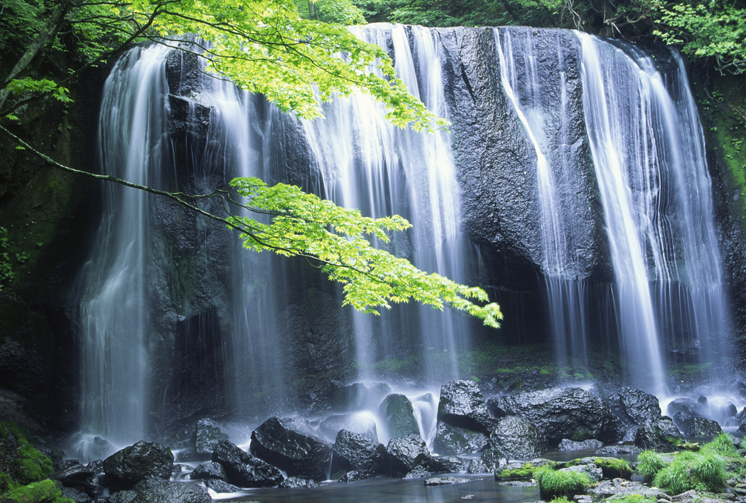
So rested he by the Tumtum tree,
And stood awhile in thought.

Slide 10
And, as in uffish thought he stood,
The Jabberwock, with eyes of flame,
Came Whiffling through the tulgey wooD,
And burbled as it came!

Slide 11
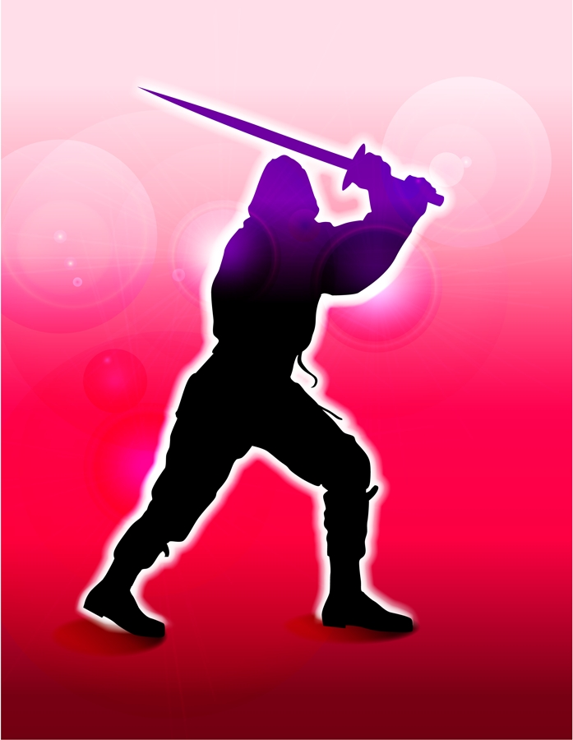
One ,two! One, two! And through and through
The vorpal blade went snicker-snack!

Slide 12
He left it dead, and with its head
He went Galumphing back.
He left it dead, and with its head
He went galumphing back.

Slide 13
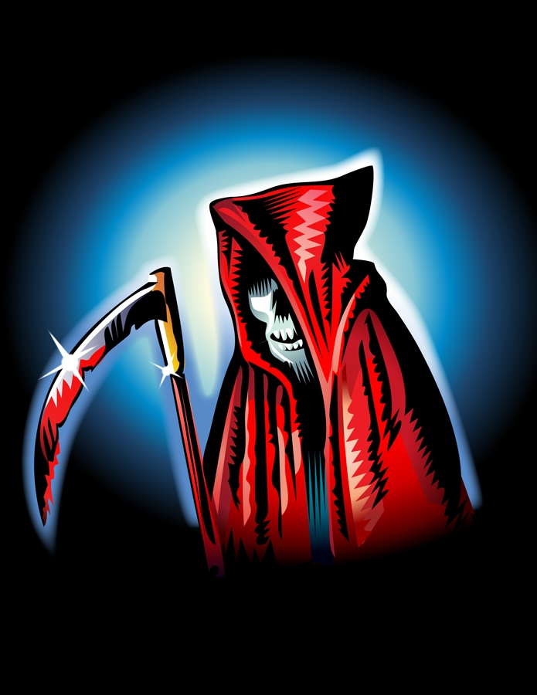
“And has thou slain the Jabberwock?
Come to my arms, my beamish boy!

Slide 14
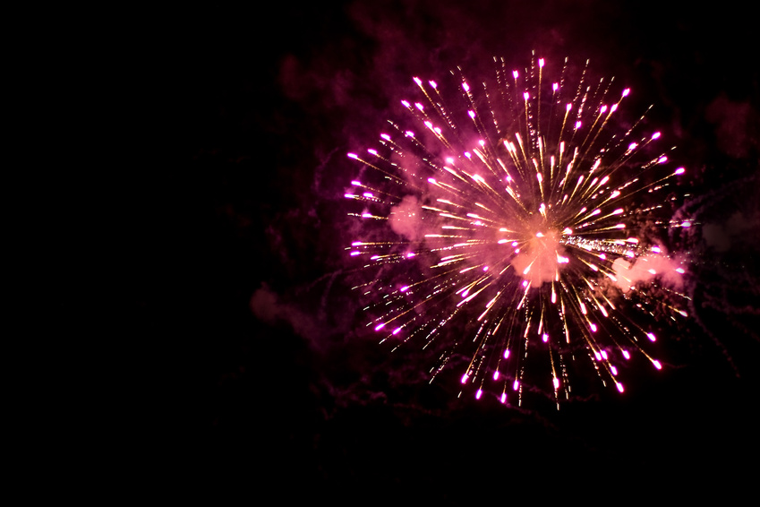
O frabjous day! Callooh! Callay!” He chortled in his joy.

Slide 15
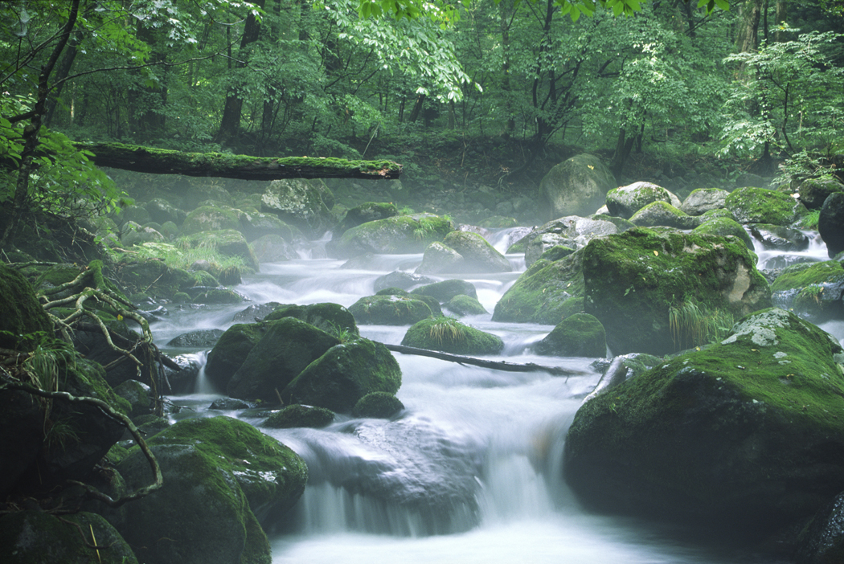
‘Twas brillig, and the slithy toves
Did gyre and gimble in the wabe.

Slide 16
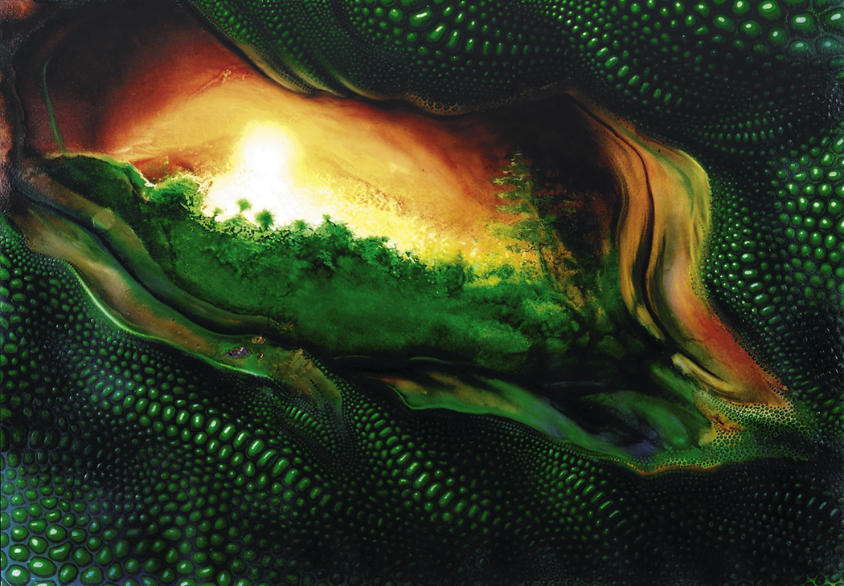
All Mimsy were the borogroves,
And the mome raths outgrabe.

Slide 17
Credits
Jabberwocky from Through the Looking-Glass and What Alice Found There, 1872
Narration ©Ron Hickey
Music: Our Coffins
Used with permission of Freeplaymusic.com
All images and photos in this project are used from Microsoft Clip Art Gallery
Storm sound wav file from Microsoft Clip Art Gallery
Click on the Jabberwock to load Activity Slide

