Slide 1
The Princess and the Pea: An e-book
Story by Hans Christian Andersen
Retold and Illustrated by Erica Boswell

Slide 2
Once upon a time, there was a prince.
He was searching for a princess to be his bride. She had to be a real princess.
Fair citizens … I am off to find a princess. Surely there is someone for me!

Slide 3
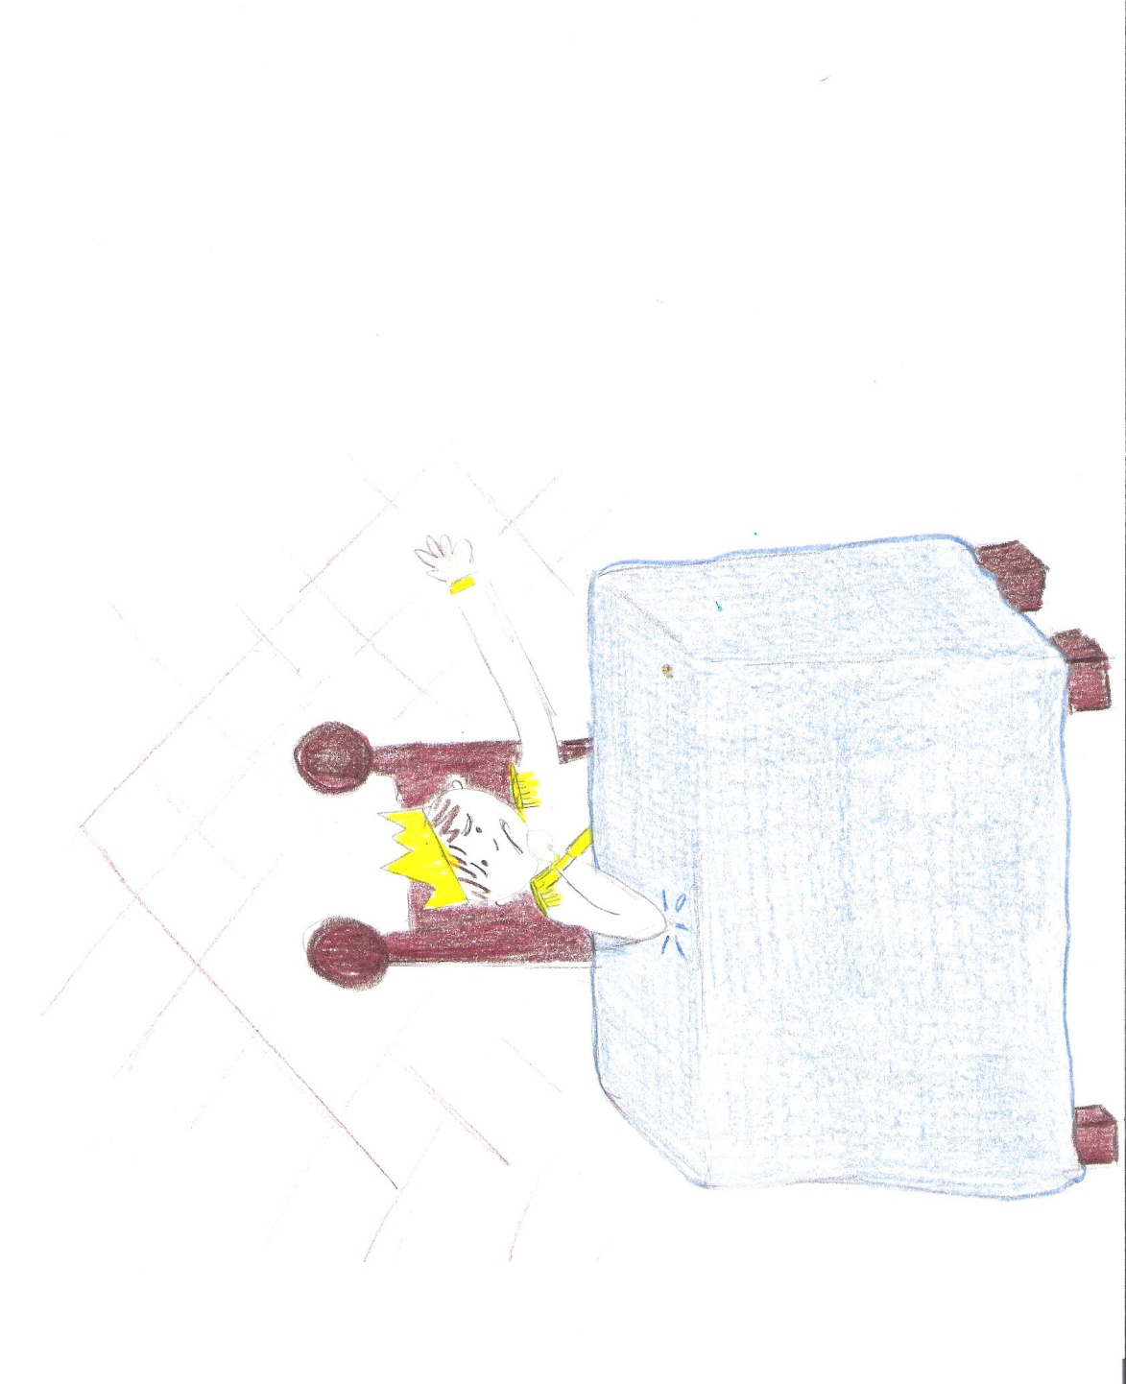
He looked … and looked … and looked. Each princess that he found had something not quite right. He could not be sure if they were real princesses.
Are there no real princesses worthy of my love?
No, no. All wrong. Be gone.

Slide 4
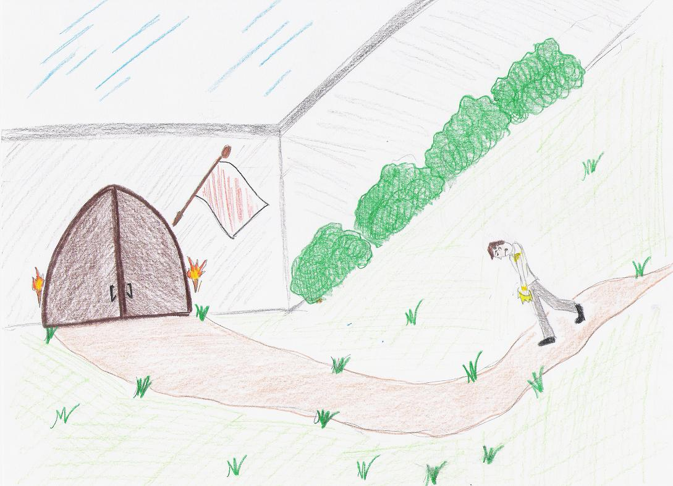
He returned home without a princess.
And he was very sad.

Slide 5
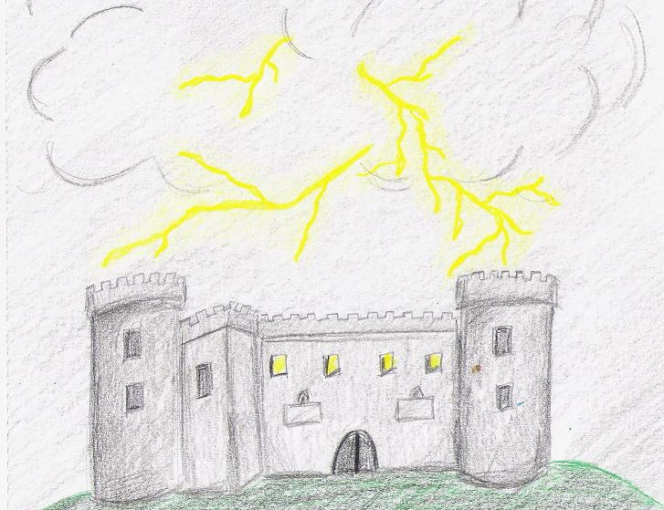
One night, there was a terrible storm.
It was raining and thundering and lightning.

Slide 6
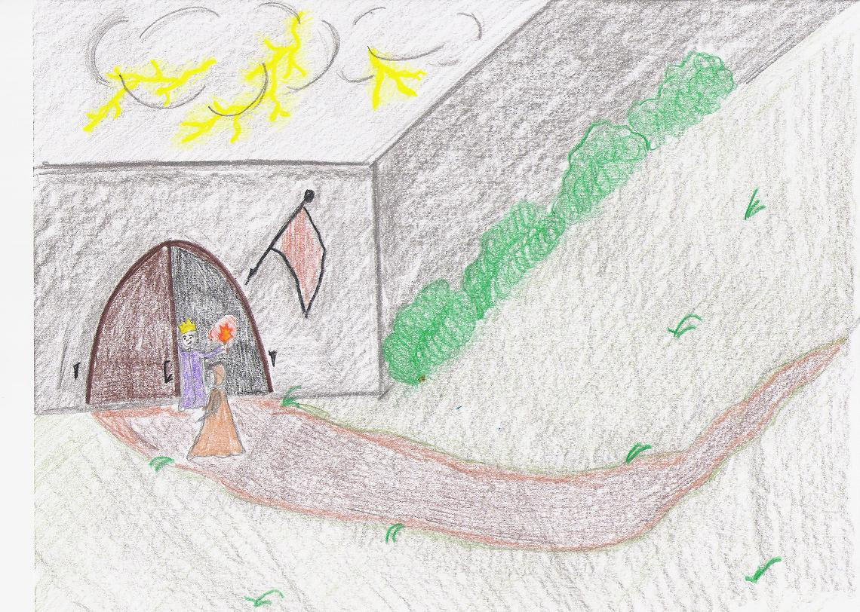
In the middle of the night, someone knocked at the town gate. The king went to investigate.

Slide 7
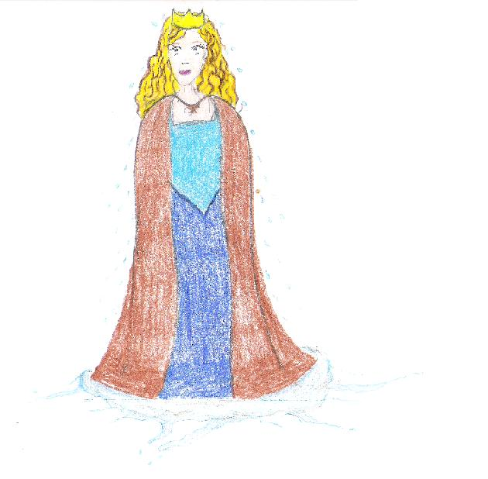
It was a girl, and she said that she was a real princess.
But she sure was a rainy mess.

Slide 8
The king allowed the princess to stay the night at the castle.
The queen was not convinced that she was a real princess.
Thank you, King. You are most kind.

Slide 9
“I will find out if she is a real princess or not,” thought the queen, and she came up with a plan.

Slide 10
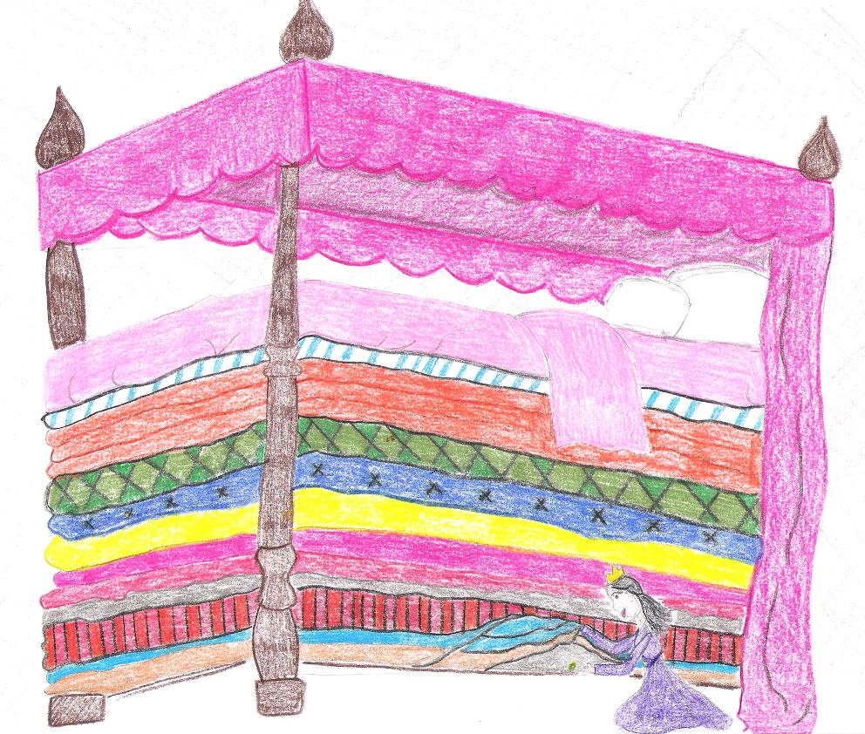
The queen crept into the bedroom and put a single pea under twenty mattresses. She then put twenty feather beds on top of that.

Slide 11
We will discover the truth in the morning.
The queen thought that she was very clever.
“Only a real princess would be able to feel a tiny pea under all
of that!”

Slide 12
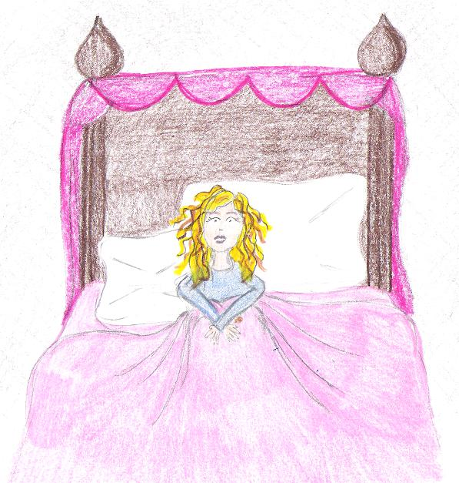
The princess tossed and turned all night.
No matter how she moved, she could not get comfortable.

Slide 13
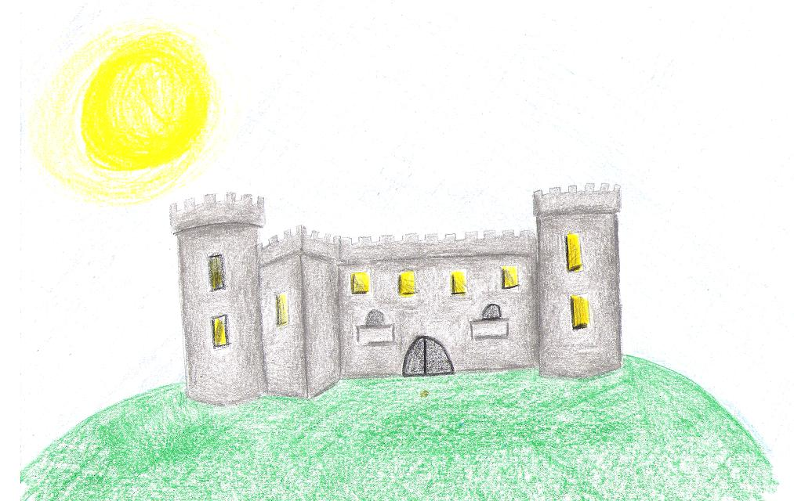
Morning finally came.

Slide 14
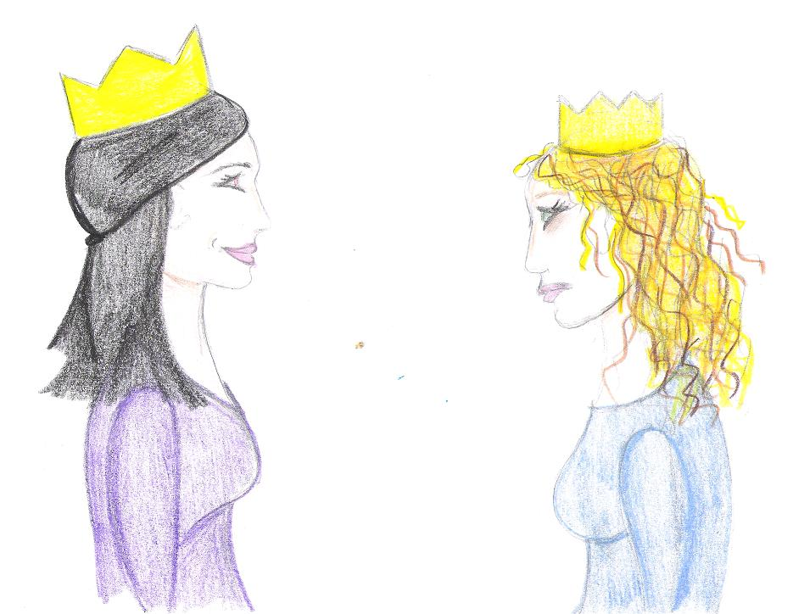
The queen asked the princess how she slept.
The princess was very tired and upset. “Oh, I hardly slept the whole night. Heavens knows what was in the bed. It was something very hard, and my whole body is bruised because of it. It was terrible!”

Slide 15
The queen was very excited because surely she must be a real princess. No one but a princess could have such delicate skin!
Hurray! She must be a real princess!

Slide 16
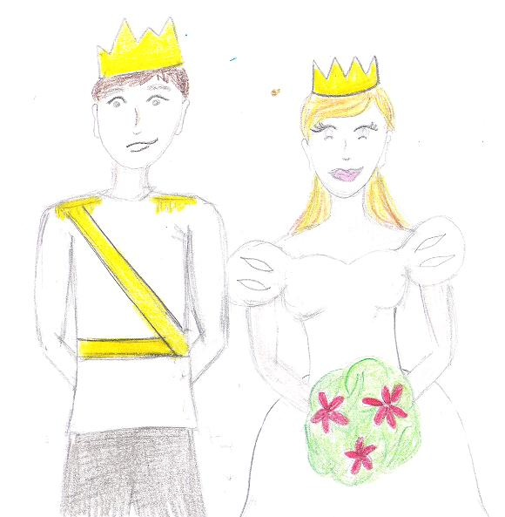
The prince was very happy because he thought that the princess was lovely.
So, the prince and princess were married.

Slide 17
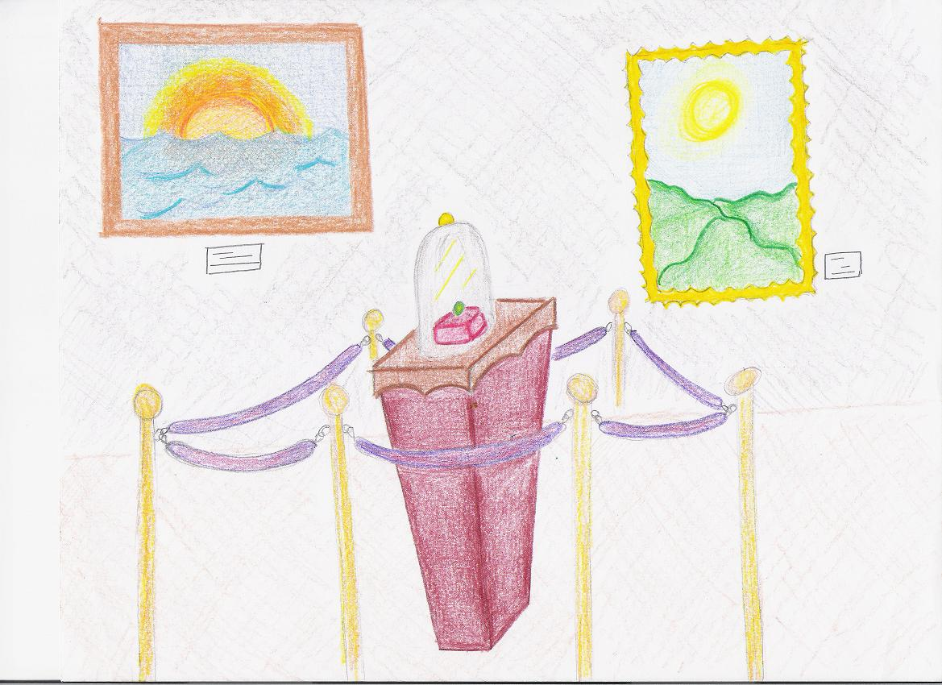
The pea was put into a museum where you can still see it today. That is, if no one has stolen it.
This is a true story.

Slide 18
The End

Slide 19
Credits
Story originally written by:
Hans Christian Andersen
Illustrations and Narration by:
Erica Boswell
Story found at:
http://bygosh.com/hca/princess.htm
Music:
“MC Handel Concerto For Trumpet And Strings In G Minor Second Movement”
www.freeplaymusic.com
Sound effects:
Microsoft Office Clip Art

