Slide 1
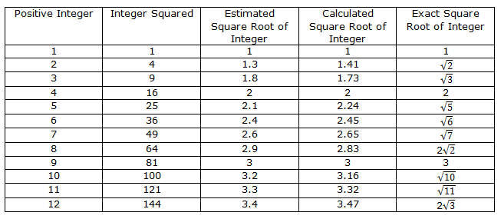
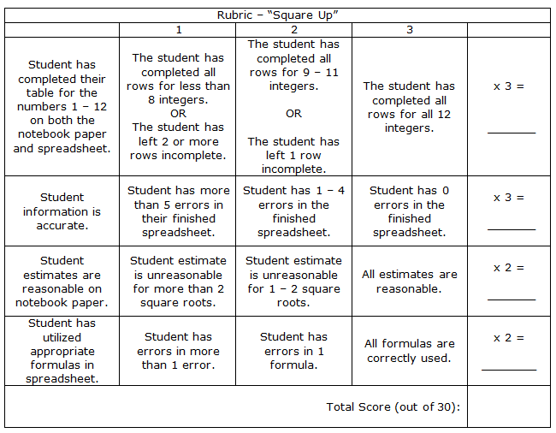
Classworks ... In the Works! Erica C. Boswell University of West Georgia
Case Scenario
Professional Development Workshop
Student Centered Activity
Classworks was implemented as way to increase math scores. Math is a critical area in this particular county.
The program serves as a remediation tool to assess students and meet them “where they are.” The teachers can provide individualized lessons, based on individual student needs.
Teachers were required to utilize Classworks on a weekly basis. Many teachers felt that this was a waste of instructional time.
The problems: An insecurity in how to adequately and effectively implement the program into the classroom. The teachers did not want it to just feel like “another thing” that they were forced to implement in the classroom.
Rather than a school wide training session, a PDW was created to allow teachers the chance to learn the program or sharpen their skills at their own pace.
A Professional Development Workshop was created using www.wikispaces.com where the teachers can complete an online training where they can work at their own pace to complete the activities and training items.
www.classworks-workshop.wikispaces.com
The ultimate goal is to have teachers develop a comfort level with the program that will allow the them to utilize the program effectively and take full advantage of all of the aspects that make Classworks great.
Through the workshop, the teachers will:
Gain a better understanding of Classworks and its various components.
Be able to set up their own classes and assign instruction.
Be able to utilize the assessment tools.
Be able to navigate the Classworks website.
The workshop was developed to help any teacher , faculty, or staff member who might have to use Classworks with students.
Through completion of the PDW, those trained will receive 2 hours of PLU credit.
Students will utilize Classworks to complete a lesson about square roots. They will then extend this information in creating a spreadsheet through Microsoft Excel. The students will:
Be able to recall the perfect squares through 144 and the square roots of these perfect squares, given either a number to a power or the square root of a number.
Analyze and investigate the relationship between a number that is a perfect square and the square roots of these numbers.
Create a spreadsheet comparing a number, it’s square root, and its square.
.
Curricular Connections
Lessons Learned
Recommended Resources
Connections between the Case Scenario and Professional Development Workshop: Without a Case Scenario, the PDW would fail to exist. The PDW addresses the concerns expressed in the Case Scenario.
Connections between the PDW and the Student Centered Activity: The Student Centered Activity is a series of tasks aligned with the information that the teacher has learned through the completion of the PDW.
Connections between Instructional Design, the Case Scenario, and the PDW: Through the struggles with designing their own classroom instruction surrounding Classworks, the faculty expressed a need to learn more about the program. The PDW was developed to address this need.
Connections between the Wikispace chapters, the Case Scenario, the PDW, and the Activity: These projects showed the whole realm of ID and each of the steps in designing effective instruction.
Lessons Learned about Myself:
I am a creative person and enjoy things that allow me the chance to exhibit this side of myself.
I appreciate being given the chance to work within a group and assign roles that are aligned with our own comfort levels – for me, this was the chance to write and work within the “editing” role.
I struggle when I don’t feel like I am doing a good job in every part of my life.
The Classworks website: www.classworks.com This website contains lots of information about Classworks and data supporting its usage
Our PDW: www.classworks-workshop.wikispaces.com
This document walks through each step of the ID process and how Classworks can help achieve learning goals
www.classworks.com/pdf/ResearchProvenSolution.pdf
This document provides ways to use Classworks to aid in the RTI Process
www.classworks.com/pdf/ResponsetoInterventionModel04-08.pdf
“Technology Helps Turn Around Struggling Students in Florida School” by Bridget McCrea
“Technology Drives Success at Alternative Education Center” by Bridget McCrea
“Classworks: A Tool for Response to Intervention” by Dr. Cynthia Millikin
Lessons Learned about Myself as a Learner:
A constant struggle of mine has been my inclination to procrastinate. I have learned that, in order to balance all of the important things in my life, I have to organize my learning and task schedule better.
I really enjoy writing! I like organizing my thoughts and stating them in a cohesive manner. I like conveying information in a written format.
I have learned that technological limitations should not inhibit your classroom ideas. You just have to be creative.

