Slide 1

David Robertson
Introducing…

Slide 2
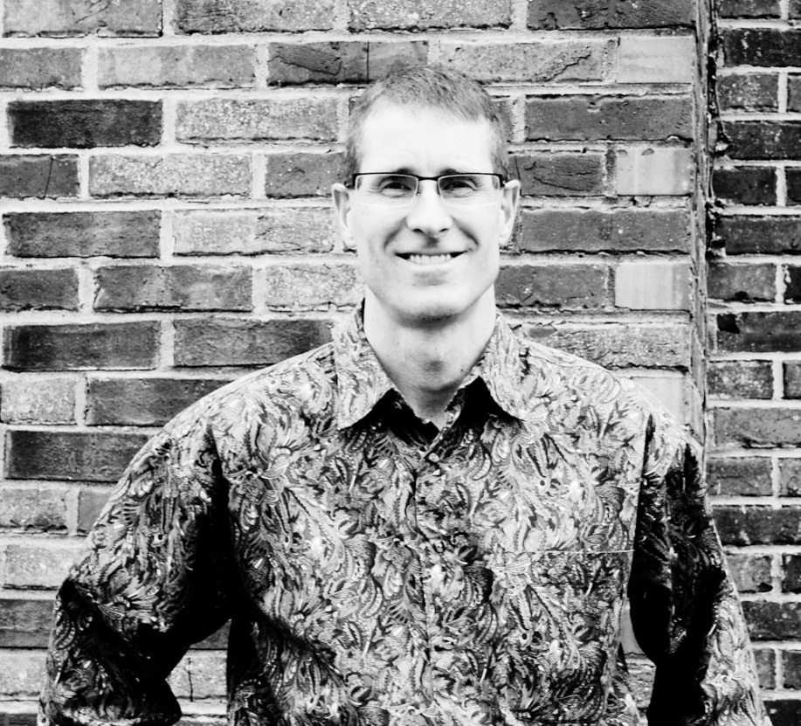

Slide 3
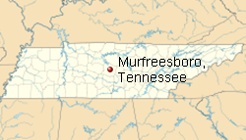

Slide 4
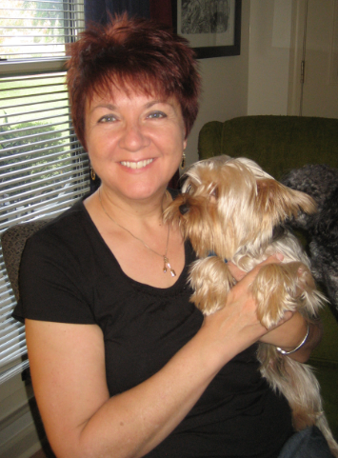

Slide 5


Slide 6
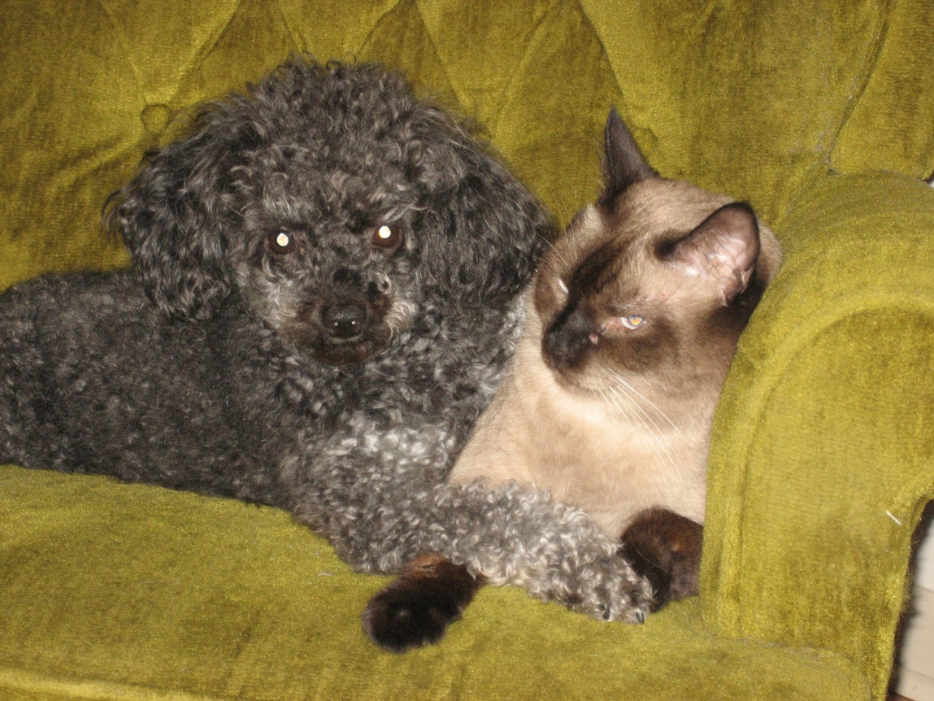

Slide 7
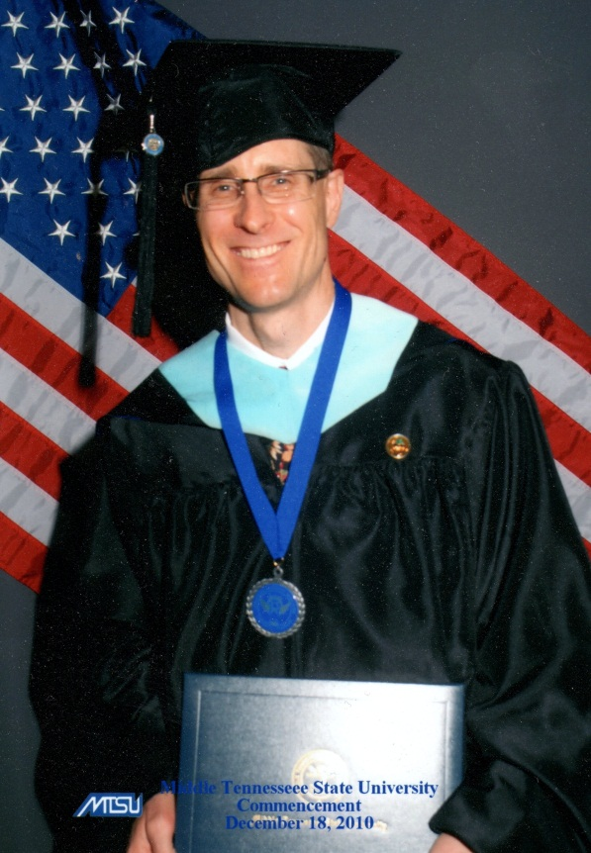

Slide 8
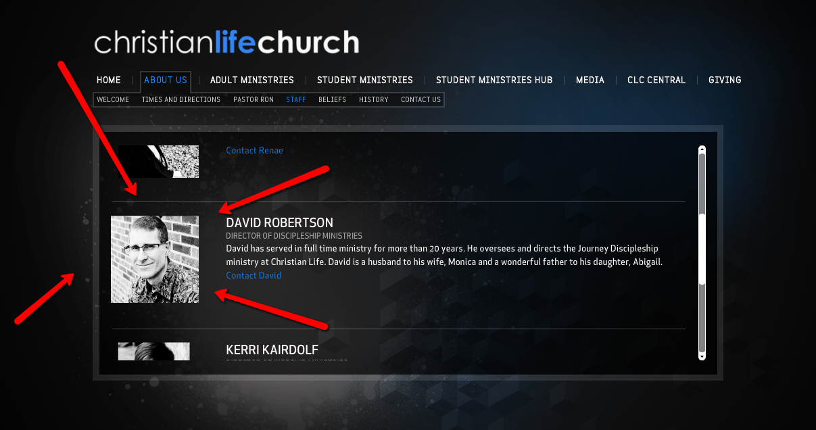

Slide 9
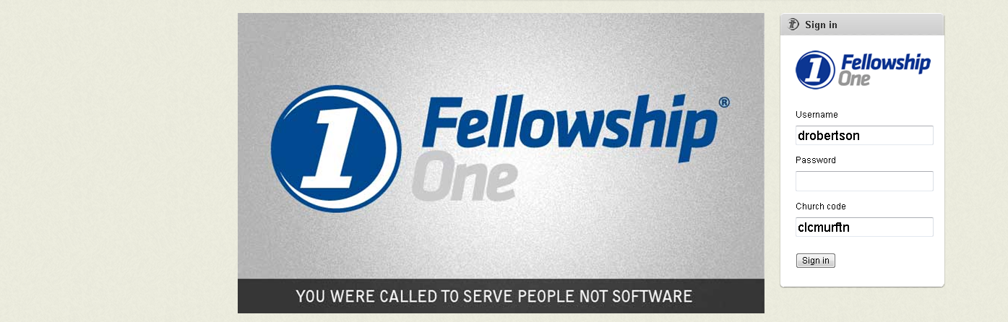

Slide 10
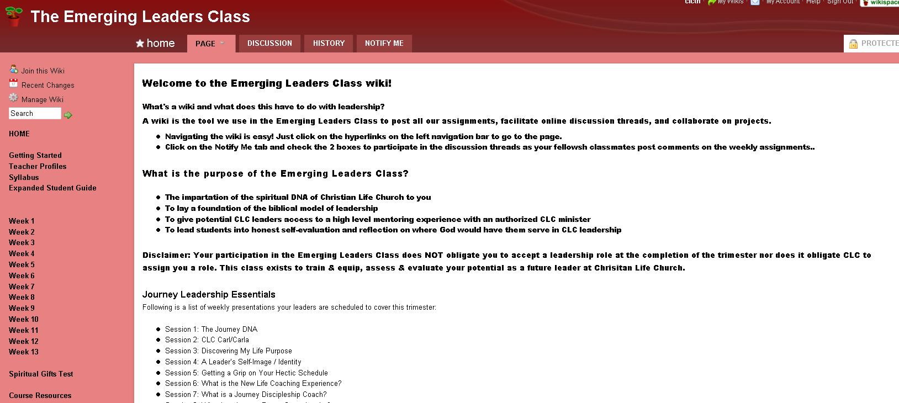

Slide 11
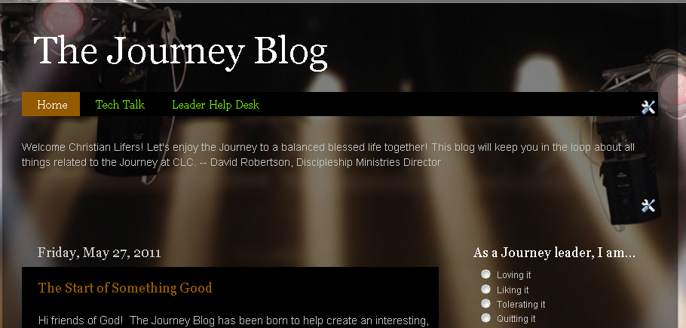
The Journey blog

Slide 12
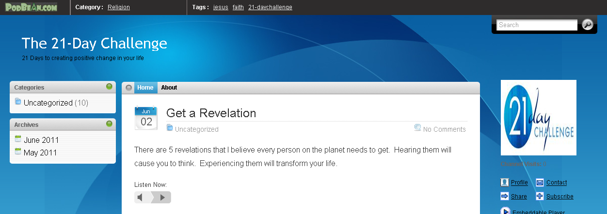
The 21-Day Challenge podcast

Slide 13
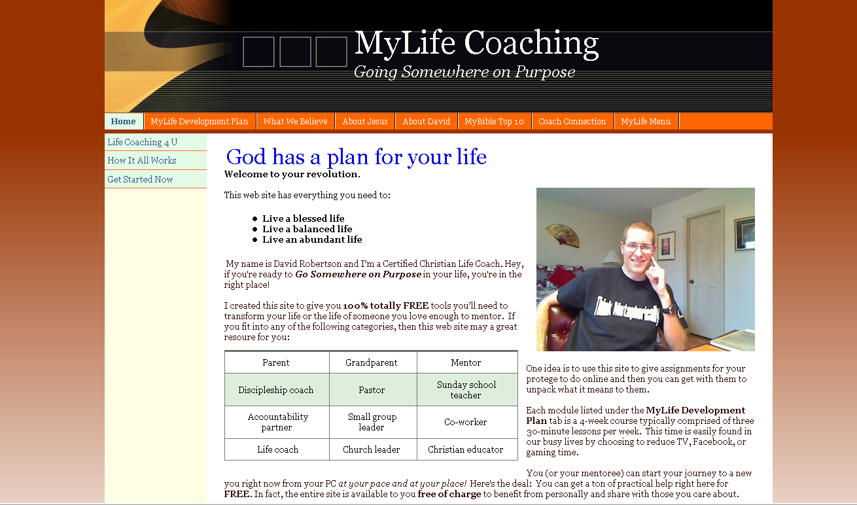

Slide 14
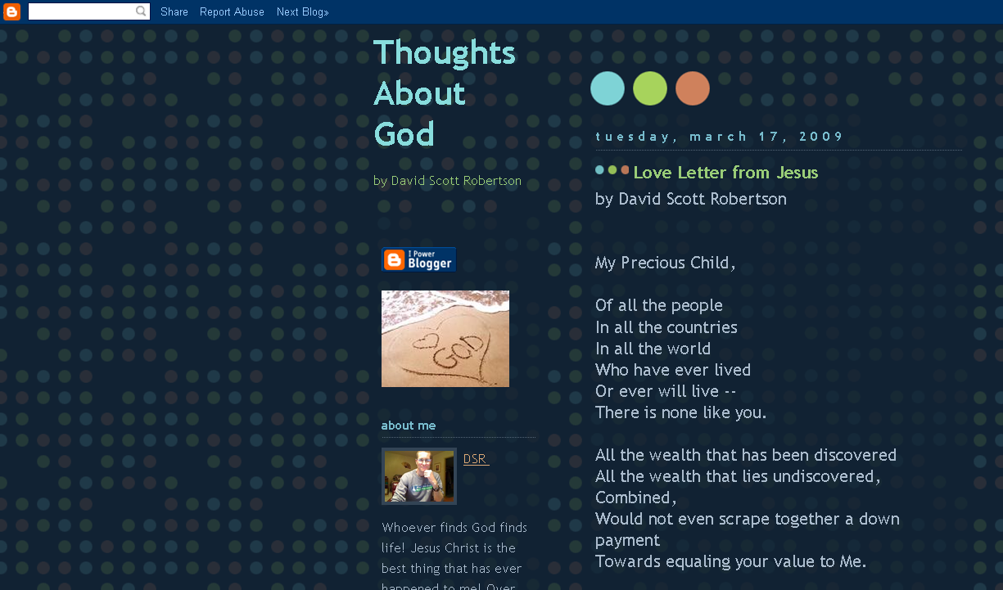

Slide 15
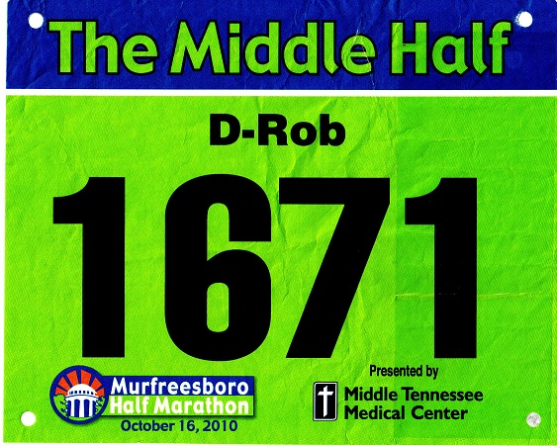
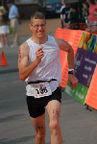

Slide 16
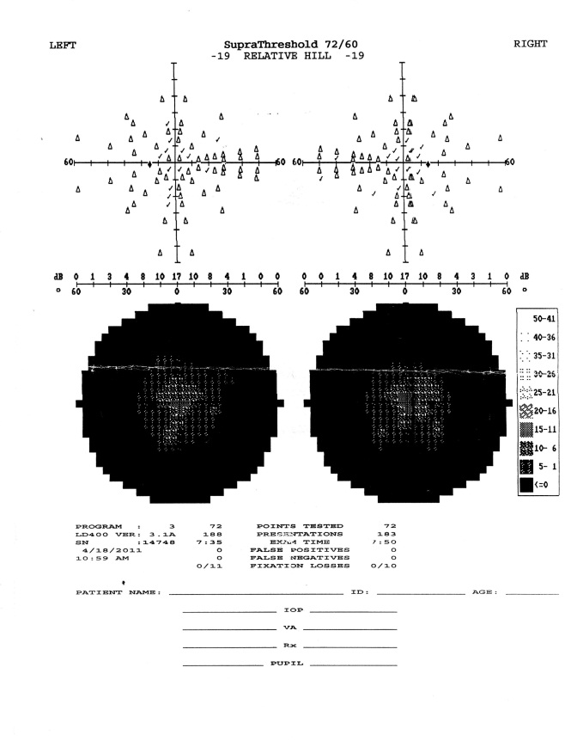

Slide 17


Slide 18
Contact Info for David
c: 615-579-9778
e: drobert9@my.westga.edu
e: drobertson777@aol.com
w: www.mylifecoaching.web.officelive.com
b: www.mylifecoaching.blogspot.com
s: david_robertson777

